Slide 1




Public Safety in the West Ward: a Discussion with the Newark Public Safety Collaborative
Dr. Alejandro Gimenez-Santana, Director
July 15, 2021

Slide 2
WWCC Planning Committee
Notes:
WWCC brings together residents, stakeholders, and elected and appointed officials, supported by researchers and other professional expertise to:
Identify and share information on current and planned redevelopment and revitalization activity (programs, strategies, etc.) in Newark’s West Ward;
Open the dialogue on opportunities and challenges in the West Ward and identify areas for collaboration, strategic planning, resource development, training, research and other activities to support improved outcomes;
Jointly develop strategies that harness the capacities of stakeholders and strategically align and facilitate partnerships to increase impacts through targeted planning and action;
Establish goals, objectives, and metrics; monitor and assess progress & mechanisms to improve information sharing among residents and stakeholders.
Visit us on Facebook

Slide 3
Questions/
Comments
Participants are invited to write questions & comments in the Chat (located at the bottom of your screen).
The moderator will take questions from the chat after the presentation.
Visit the WWCC website for a copy of this presentation. https://oucp.newark.rutgers.edu/partnerships/west-ward-community-coalition/

Slide 4
Agenda
Welcome & Introductions
Dr. Diane Hill, Rutgers University-Newark
Greetings
Bishop Rudy V. Carlton, Jehovah-Jireh Praise & Worship Church Center
Presentation
Dr. Alejandro Gimenez-Santana, Newark Public Safety
Collaborative
Discussion & Questions

Slide 5
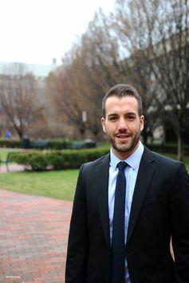
Presenter
Dr. Alejandro Gimenez-Santana, Director Newark Public Safety Collaborative
Email: newark.collaborative@rutgers.edu Phone: (973) 353-3310 Address: Center for Law and Justice, 123 Washington Ave, 5th floor Newark NJ 07102

Slide 6

The Newark Public Safety Collaborative
Dr. Alejandro Giménez-Santana, NPSC Director
Asst. Prof. of Prof. Practice, School of Criminal Justice

Slide 7

NPSC
Strategic Goals:
  Data-Informed Community Engagement (DICE)
  Convene local stakeholders in a collaborative effort to reduce crime in the city of Newark
  Deliver actionable data and insights
  Propose programs to impact change in the community
  Engage in urban transformation

Slide 8
Data-informed community engagement
Under the DICE framework, NPSC seeks to
    (1) democratize the use of data and analytics,
    (2) empower community organizations to become coproducers of public safety, and
    (3) mobilize community resources and expertise to problem-solve Newark’s most pressing crime issues.
Public safety is reimagined as a holistic process by which community agencies, including police, participate to share the burden of public safety.
Community-based organizations (CBOs), police and other local stakeholders, obtain equal access to data and analytics to solve problems and make decisions in a coordinated fashion.

Slide 9
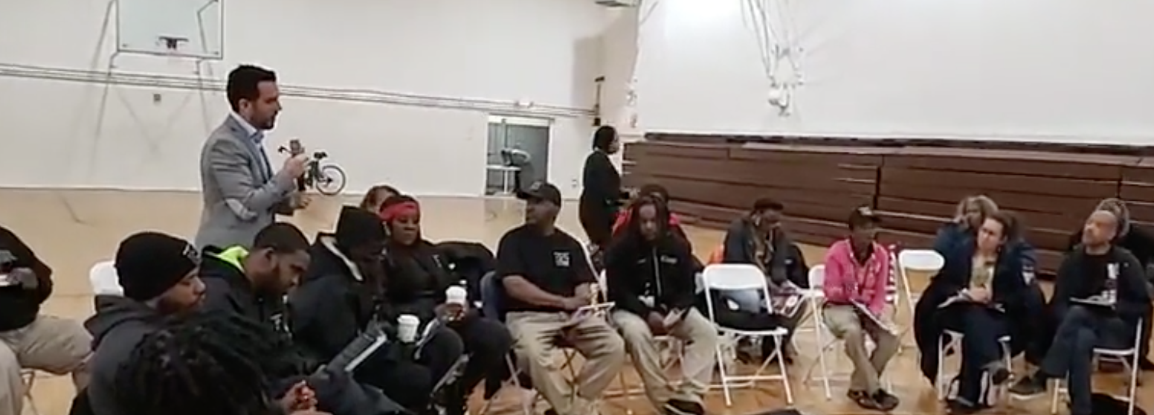
Data-informed Community engagement
NPSC staff members attend community meetings to disseminate data, address questions from community partners and residents, and mobilizing resources where needed the most.

Slide 10
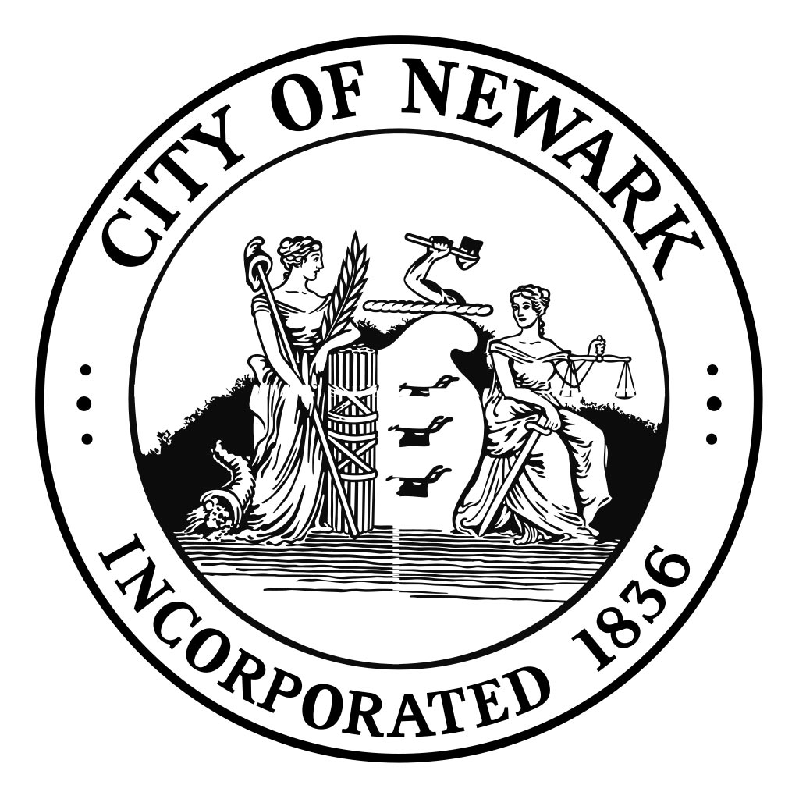
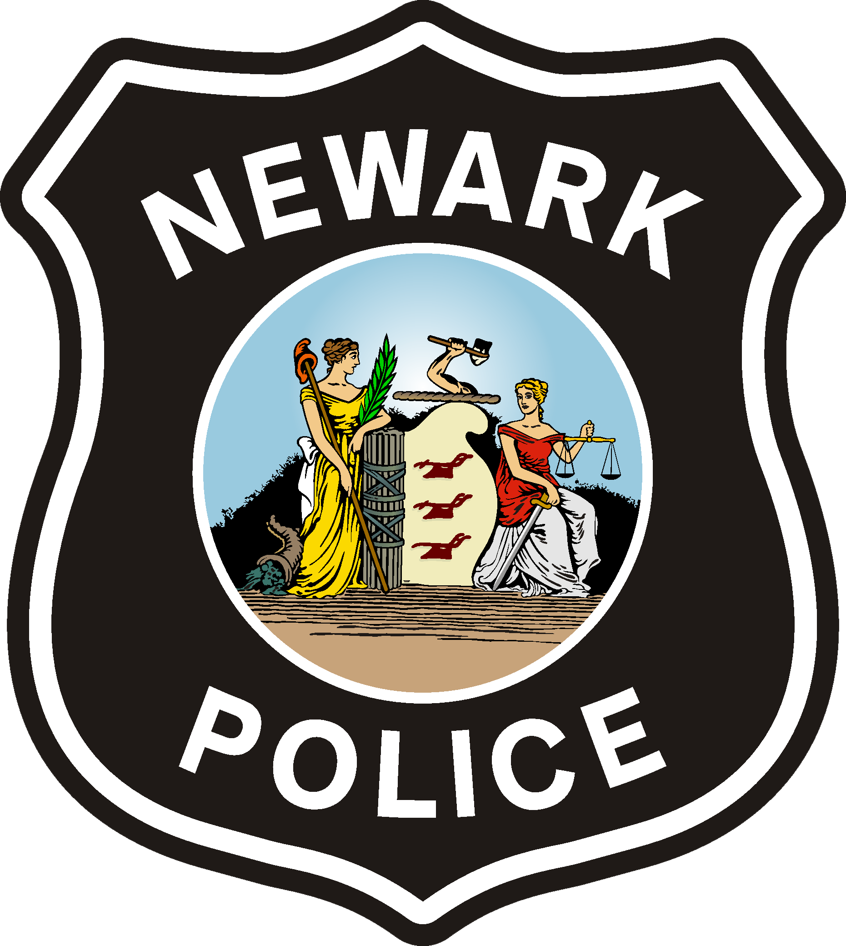






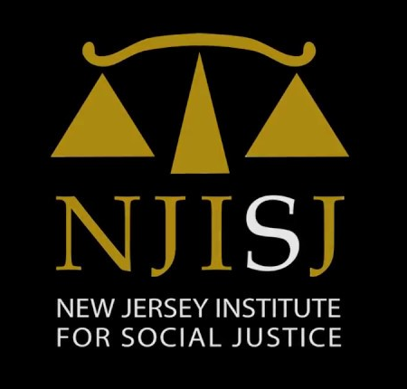



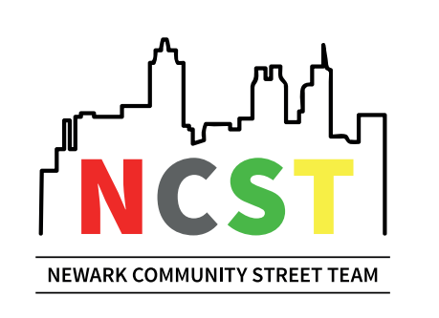










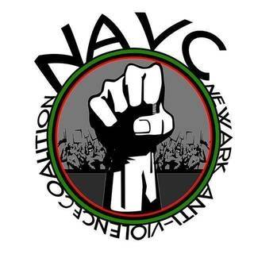



NPSC COMMUNITY PARTNERS
CONVENE LOCAL STAKEHOLDERS

Slide 11
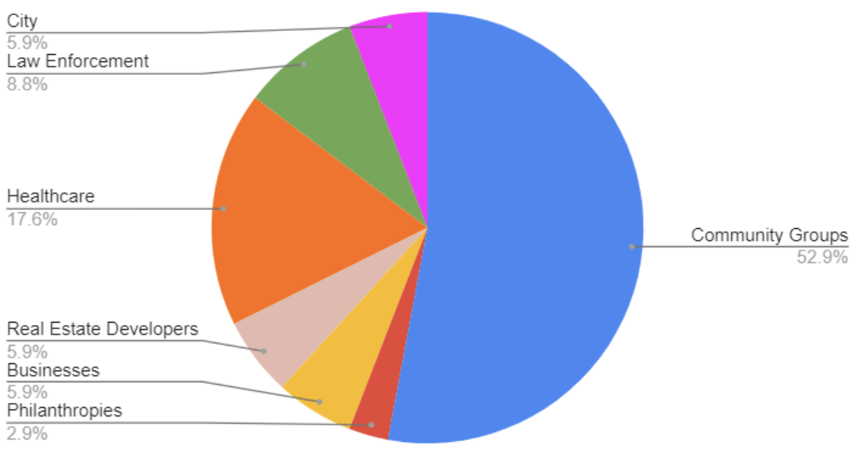
Focus on community groups
The NPSC serves a diverse network of stakeholders from different constituencies and sectors of Newark, including community-based grassroots organizations and large corporations.

Slide 12
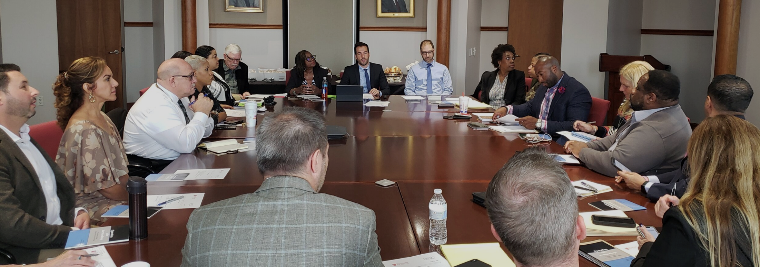
NPSC meetings
“Our goal is to make data analytics accessible to community groups who are the local experts and change agents. We support their efforts.”

Slide 13
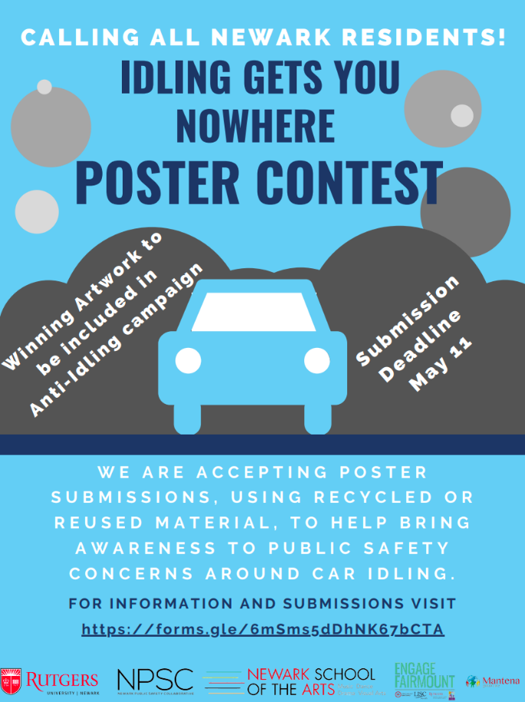
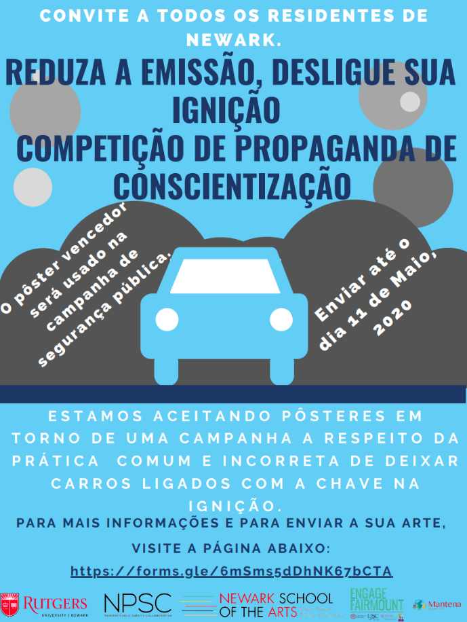
poster competition to prevent car theft
The NPSC, and several of its partner organizations are actively collaborating in a Data-Informed Community Engagement activity designed to raise awareness of the risks associated with idling.

Slide 14

You can find more information at our dedicated website: publicsafetycollaborative.org
If you have any questions, comments, or feedback, you can email us at: newark.collaborative@rutgers.edu

Slide 15
Contact
WWCC @
The Office of University-Community Partnerships,
Rutgers University-Newark
973-353-1630 (phone)
Donita Devance, Associate Director/WWCC Coordinator
Tyeshia Dawson, OUCP Intern
WWCC Website
https://oucp.newark.rutgers.edu/partnerships/west-ward-community-coalition/

Slide 16
