Slide 1
West Ward Community Coalition
Community Conversations
December 20, 2016

Slide 2
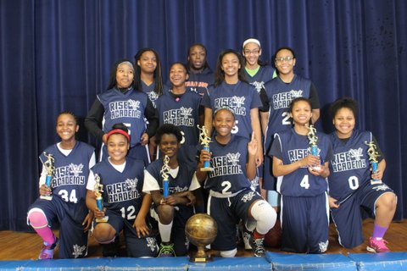
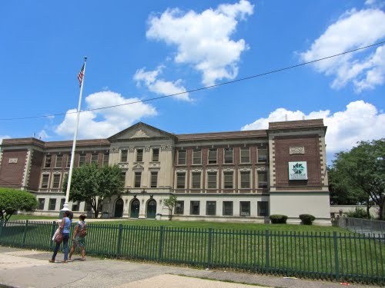
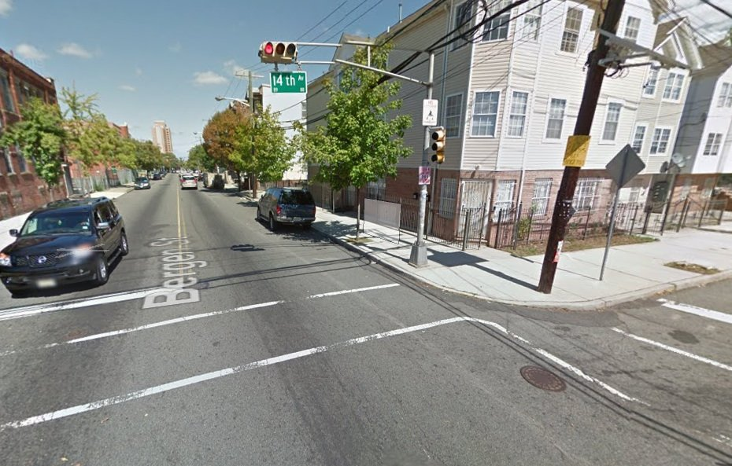
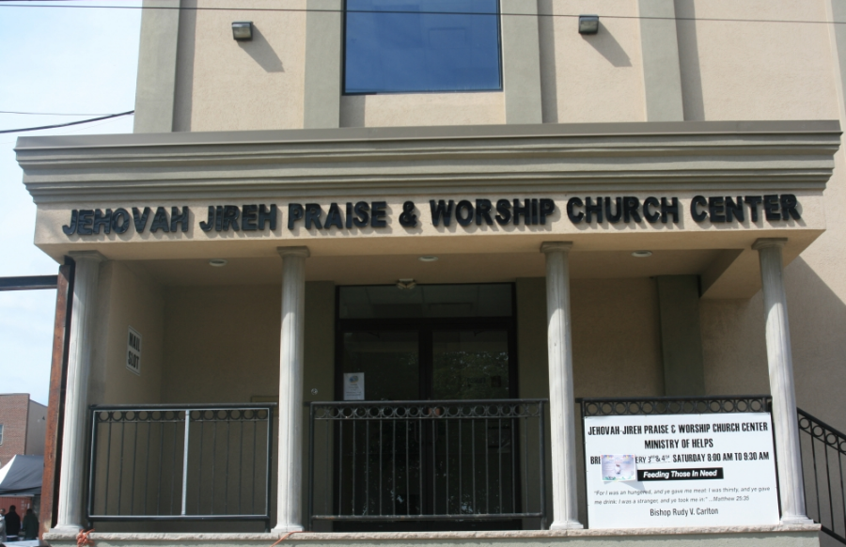
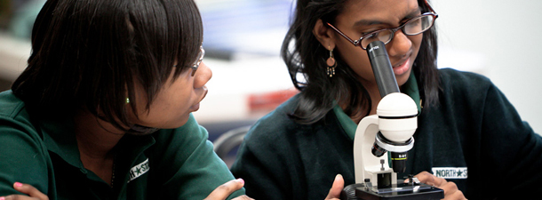
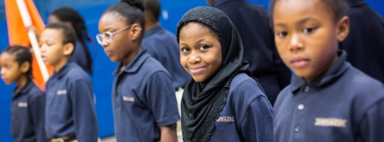
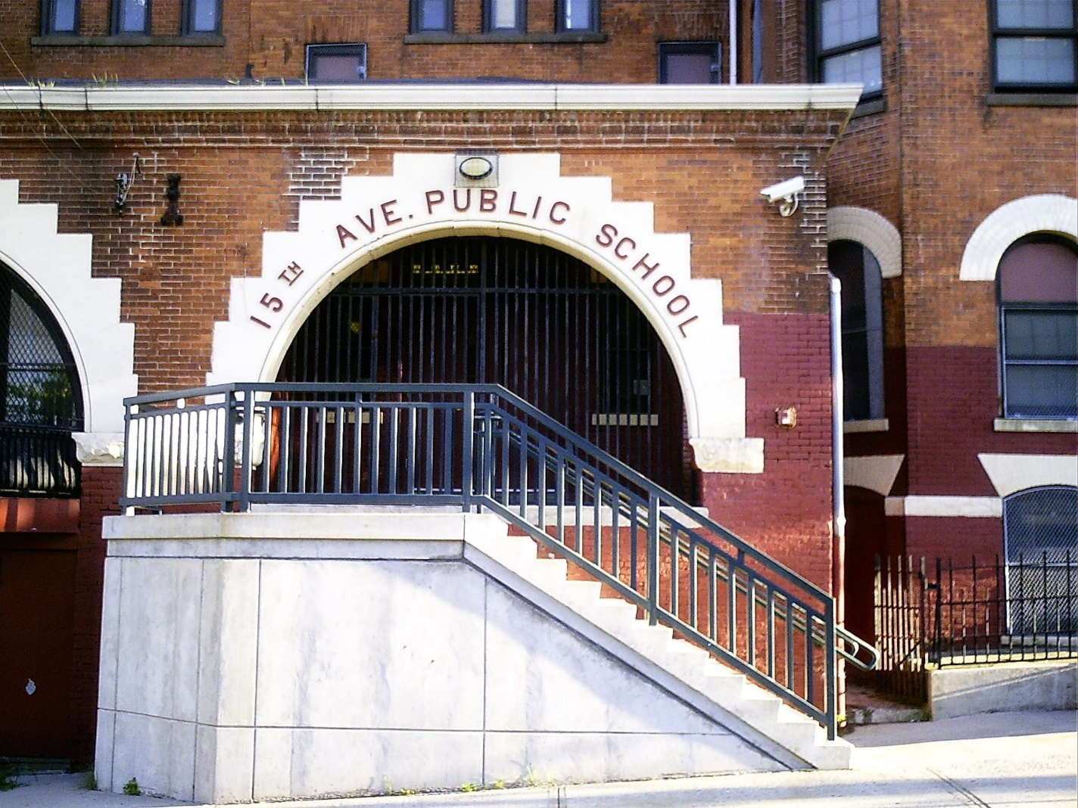
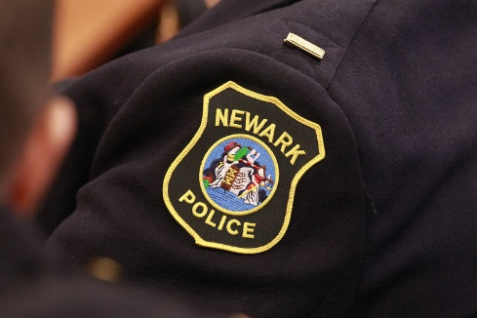
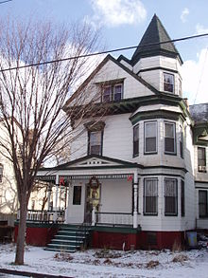
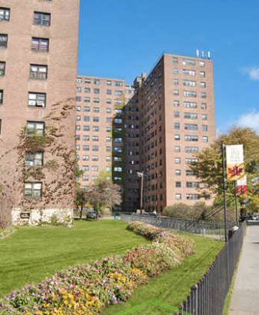

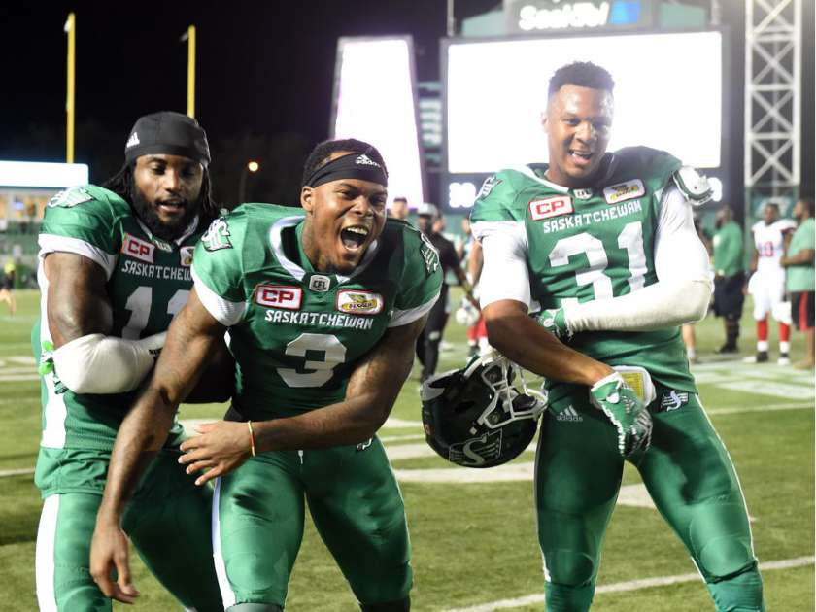
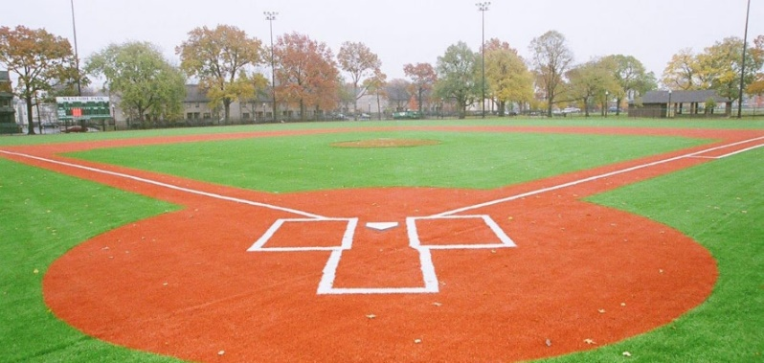
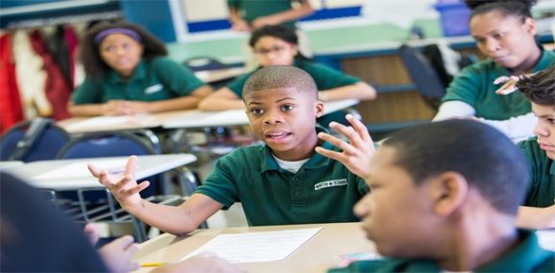

Slide 3
Hosts

Slide 4
Agenda
Welcome & Introductions – Councilman Joseph McCallum &
Dr. Diane Hill
The West Ward in Context – Senator Ronald Rice
Presentations
  * Public Safety * Economic Development
  * Education * Health
  * Employment * Housing
Questions & Dialogue
Next Steps & Wrap Up

Slide 5
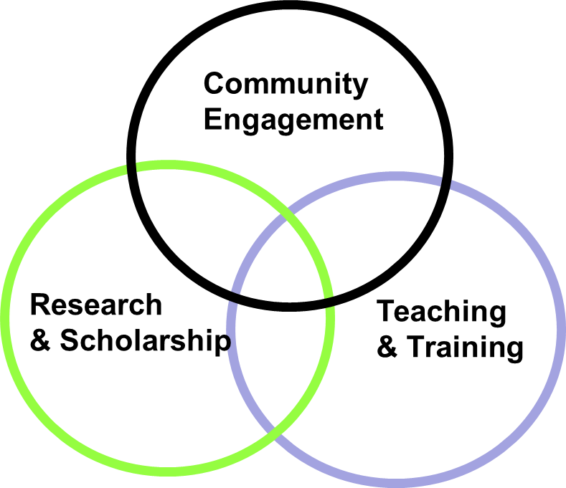
“Building Brides to the Community”
Office of University-Community Partnerships (OUCP)
Rutgers University-Newark (RU-N)
Serves as a nexus that connects Rutgers University-Newark-students, faculty and staff-to forge, create and promote reciprocal and mutually beneficial partnerships that support and align with institutional strategic engagement priorities.
Notes:
Facilitate partnerships and expand engagement opportunities to support strategic plan
Provide tools for faculty, staff & students to engage in mutually beneficial community partnerships.
Serve as the technical assistance provider for the Chancellor’s Seed Grant Initiative out of the Graduate School.

Slide 6
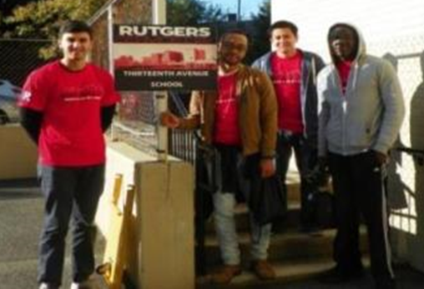
OUCP offers professional services to strengthen RU-N’s capacity to positively impact the quality of life in Newark and beyond via publicly-engaged scholarship and collaboration by:
Cultivating meaningful partnerships between the university and community members;
Expanding and enhancing opportunities
for student community engagement;
Supporting campus-wide community engagement opportunities for faculty, staff and students;
Fostering engaged urban research collaborations.

Slide 7
West Ward Community Conversations
Purpose:
Open the dialogue on opportunities and challenges in Newark’s West Ward and identify areas for research and collaborative work to support improved outcomes.
Highlight programs and initiatives that represent the way forward in Education, Public Safety, Economic Development, Housing, Health, etc.
Facilitate strategic partnerships to increase impacts through targeted planning and action.

Slide 8
Public Safety
Safer Newark Council
Elizabeth Ruebman, Executive Vice President, Amplify, Inc. &
Dr. Leigh Grossman, Rutgers University–Embedded Researcher, Newark Police Department, Real Time Crime Center
Newark Community Street Team
Nathaniel Burkard, Project Administrator

Slide 9

Overview of SNC
Development of SNC: Developed out of a 2014 public safety retreat
  Generated a list of 35 initiatives underway in Newark
  The issue was not a need for more action, but a need for coordination and integration with a focus on data about the most pressing needs
Mayor Baraka’s charge to the group: Newark needs an organized and systematic strategy beyond law enforcement alone.
  Provide an independent assessment of the current status of public safety in Newark.
  Identify and promote a set of strategic priorities for improving Newark’s public safety citywide.
  Create a medium for aligning evidence-based and problem-oriented public safety initiatives with these strategic priorities

Slide 10
Newark Public Safety Data Review
Newark’s overall crime rate is not out of line with similar cities
What sets Newark apart is its high rate of murders and robberies
Murders and robberies concentrate in locations
Murders and robberies concentrate among groups of residents
A place/person targeted strategy for reducing murder and robbery is Newark’s highest priority

Slide 11
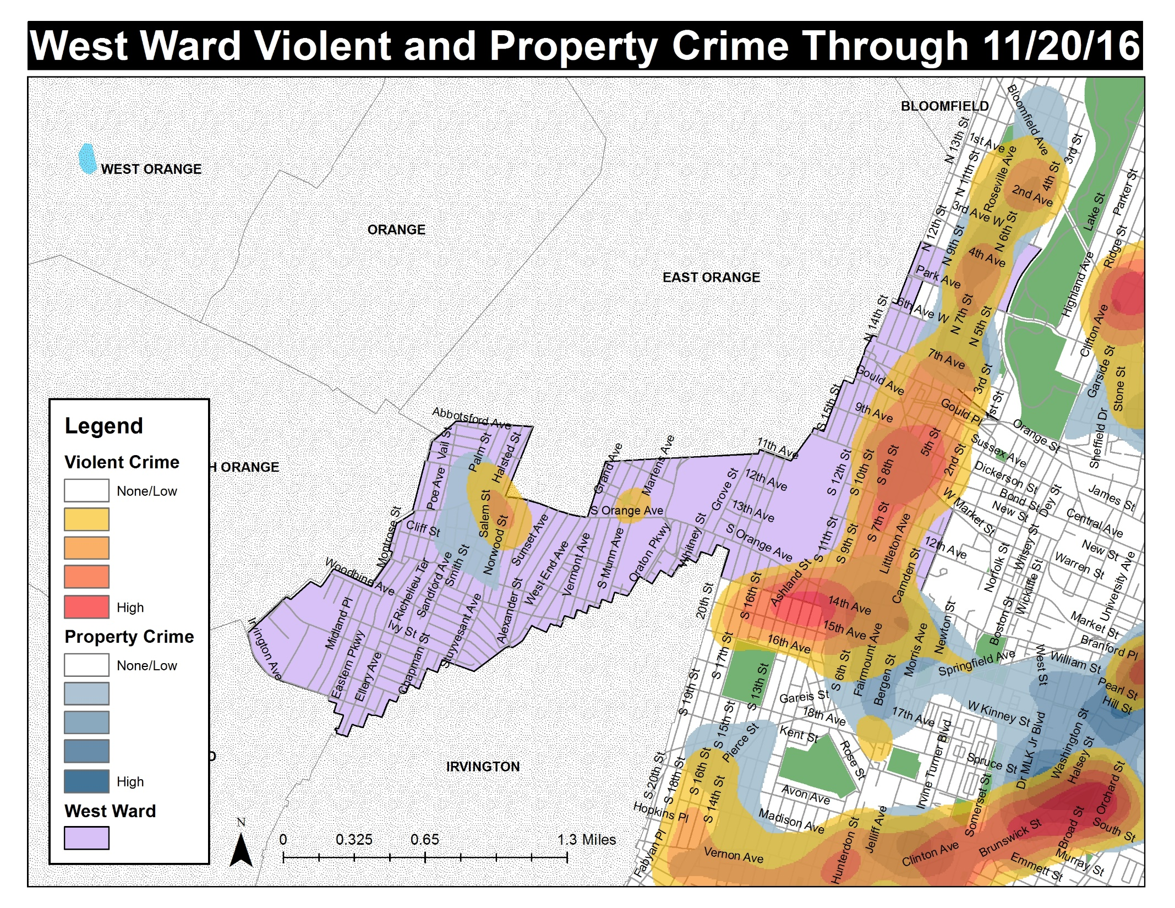
 | % Change Through 11/20/16 Compared to 11/20/15
Murder | -15.0%
Aggravated Assault | -3.4%
Robbery | -27.4%
Auto Theft | -20.3%
Burglary | -25.5%
Theft | -30.5%
Theft From Auto | -3.4%

Slide 12
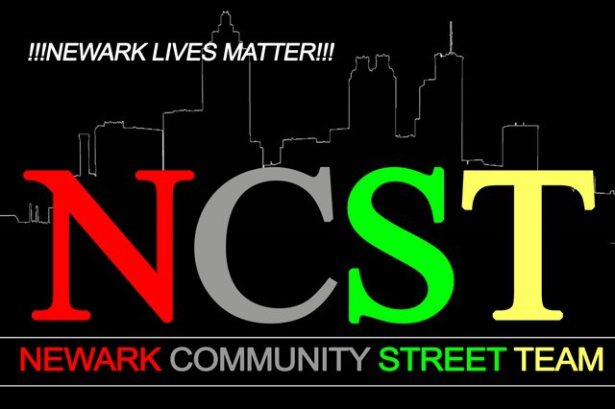
Who We Are
&
What We Do

Slide 13
The Newark Community Street
Team is…
A Project of the Mayor’s office
The Violence Reduction Component of the MNI in the South and West Ward
Comprised of 17 Outreach Workers who live in, are from or are directly tied to the neighborhoods they work in.

Slide 14
NCST PHILOSOPHY…
We view violence as not only a public safety issue but also a public HEALTH issue.
We believe the most powerful voice in the healing of historical and systemic traumas our young men and women face is the support, understanding and influence of peers.
We believe that we can reduce violence by preventing retaliation as well as conflict mediation

Slide 15
Services we provide…
Navigation through all city and state services.
VCCB funding applications for crime survivors
Safe Passage
The Hardship Fund
Free Legal Services
Mental Health and Wellness Services through The Department of Health and Wellness
The Ameri-I-Can life skills curriculum
And Referrals…

Slide 16
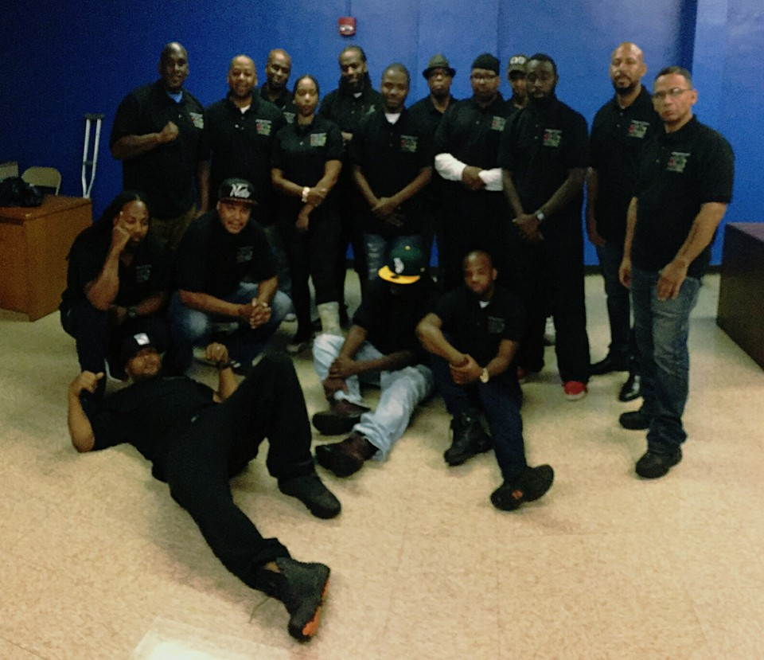
Thank You for you support and we look forward to working with you soon.

Slide 17

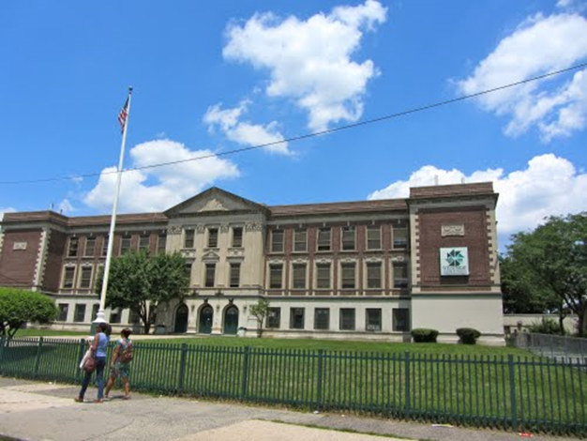
Education
Jumpstart (Pre-K)
Zakkiyah Sally, Program Manager
Newark Fairmount Promise Neighborhood (NFPN) (Pre-K – 12 & beyond)
Tia Teabout Collier, Director

Slide 18

C

Slide 19







The Literacy Partnership
Leveraging the power of community & positive adult-child relationships to build the key language and literacy skills children need to take on the world.

Slide 20
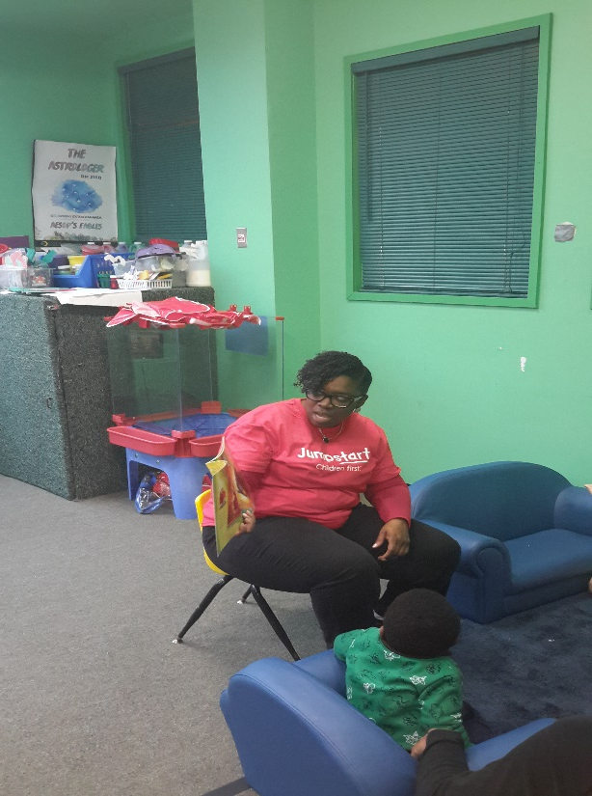
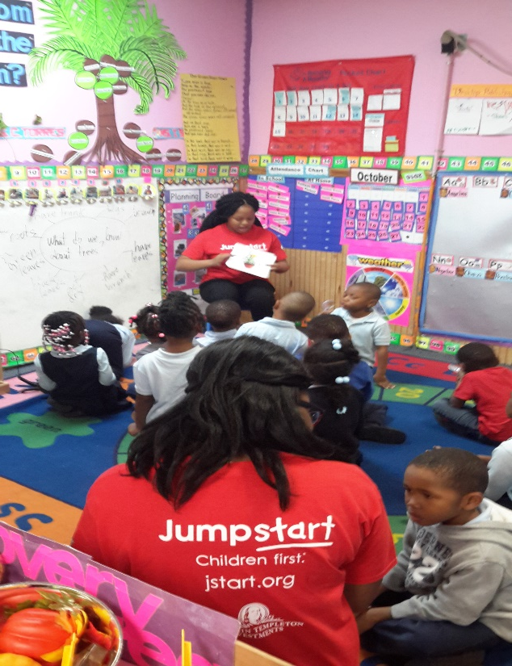
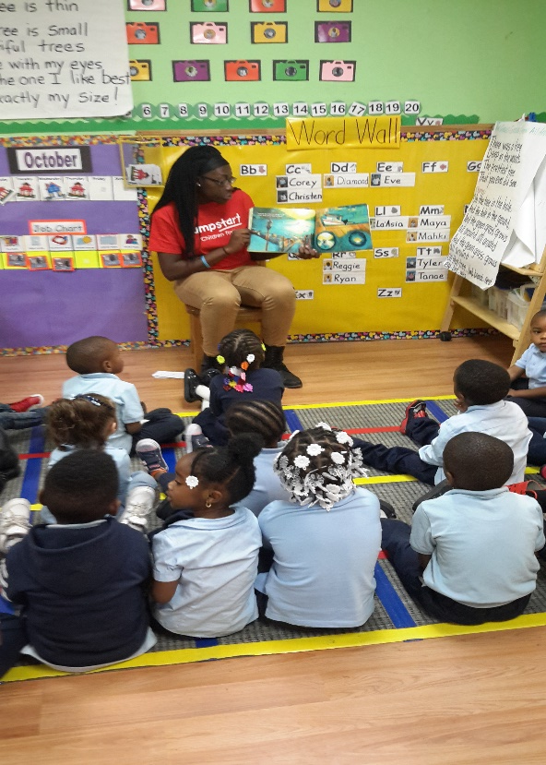
Jumpstart’s Mission
Working towards the day every child in America enters kindergarten prepared to succeed.

Slide 21
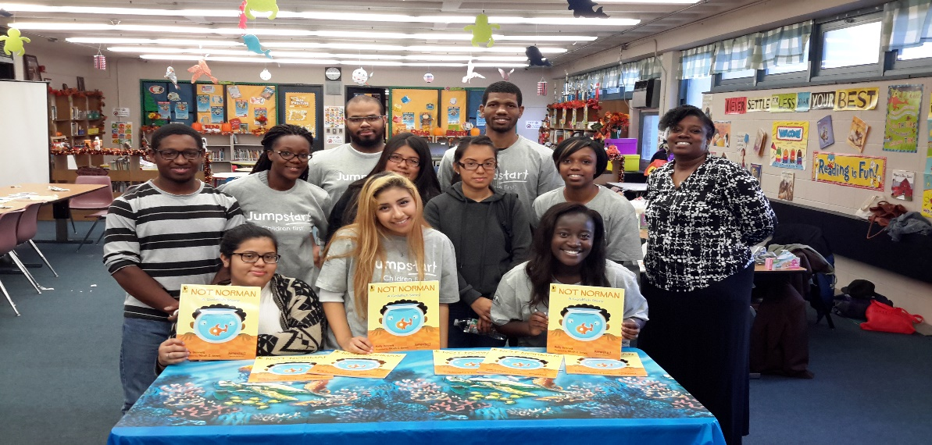
West Ward Educational Community Affiliates
13th Avenue School
Full Gospel Christian Academy
Urban League Child Development Center
Early Childhood West Preschool
New-Ark Freedom School

Slide 22
Literacy Volunteer Opportunities
Read for the Record. A Jumpstart national campaign to bring young children together with valued grownups in their lives to read the same book, on the same day, in communities all over the world.
Celebrity Reads. A United Way of Essex County literacy initiative that recruits volunteers to model their love of reading and the pursuit of education as a pathway to success in local elementary school classrooms.
Read Across America. Annual program targets reading to celebrate the birthday of beloved children's author Theodor Geisel (Dr. Seuss) on March 2.
New-Ark Freedom School. “Harambee” is the opening activity that starts each day in celebration with singing and reading. Community leaders and role models participate to inspire youth.

Slide 23
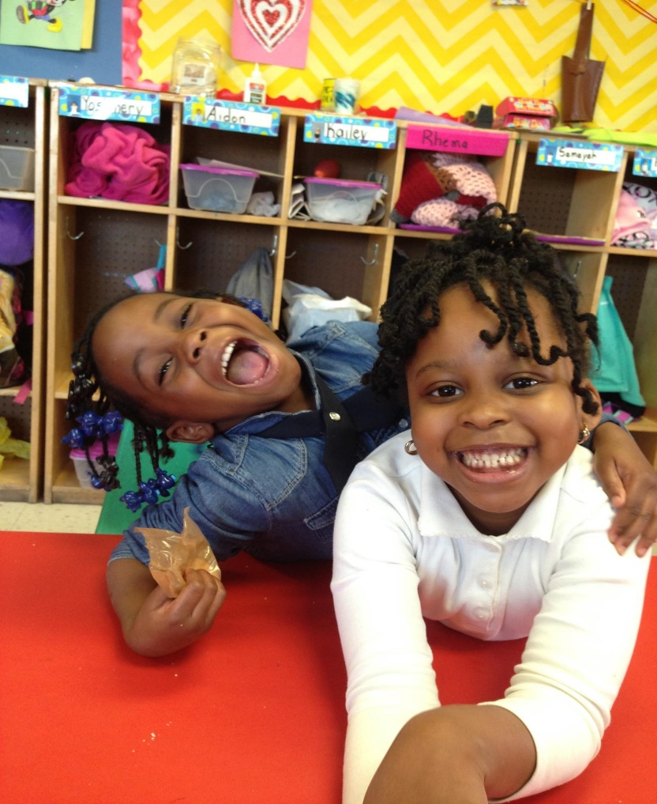
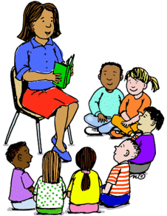



"The more that you READ, the more things you will KNOW. The more that you LEARN, the more places you'll GO ." - Dr. Seuss

Slide 24
Newark Fairmount Promise Neighborhood

Slide 25

Meet Bryan…
https://www.youtube.com/watch?v=IJJYnDiZbPg

Slide 26
Employment
Rutgers Express Newark
  Victor Davson
Urban League of Essex County
Patricia Sermon, Vice President, Workforce Development & Financial Opportunity Center

Slide 28
Express Newark
A “third space” 1 for arts collaboration where people from the community and university meet on equal terms and co-create, experiment and innovate, engage in creative practice, foster democratic dialogue, and promote positive transformation

Slide 29
Express Newark
Express Newark will become a vital element in Newark’s burgeoning Arts District, linking the Newark Museum, the New Jersey Performing Arts Center, newly renovated Military Park, WBGO, Halsey Street studio art spaces, the great hall at 15 Washington Street, and the Newark Public Library. It directly addresses one of the chief goals of Rutgers University – Newark’s strategic plan: to create third spaces in which to engage collaboratively with community partners as a way of further fulfilling our proud tradition of anchor institution investment in the city of Newark.

Slide 30
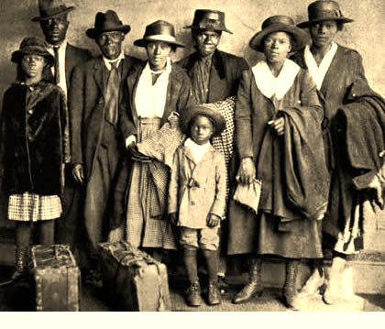
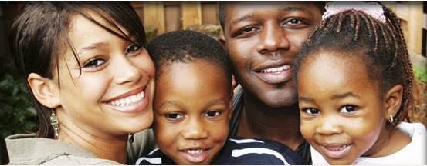
Our History: Founded in 1917
The League was formed to give help and hope to the many thousands seeking relief and opportunity in the north in “The Great Migration”. For nearly a century, we have been dedicated to empowering individuals and families in Newark and Essex County.
Our Mission:
To assist African Americans and disadvantaged individuals in achieving social and economic self sufficiency.

Slide 31
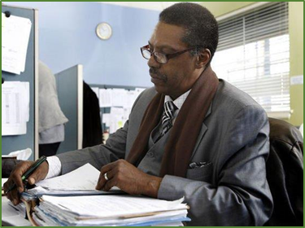

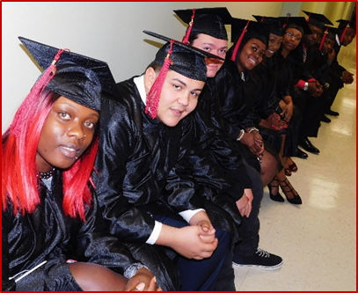



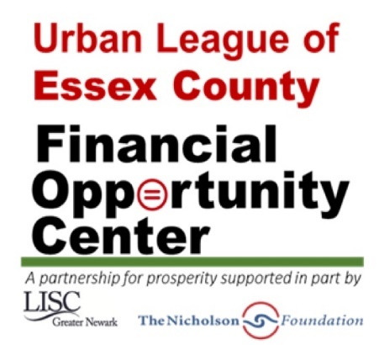
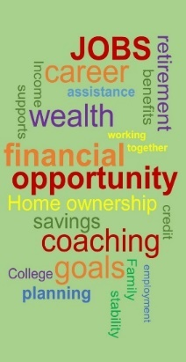





Empowering Communities. Changing Lives.
We carry out our mission through effective programs and services, bridge-building and advocacy.
Urban Senior Jobs Program
Bridges
to Home Ownership
HUD Certified Housing Counseling
FACE FORWARD
Urban Youth Empowerment Program

Slide 32

Financial Opportunity Center (FOC)
Opened: November 2015
Focus: On the financial bottom line for individuals and families where we provide services across three broad areas:
  Public benefits screening
  Employment services and career improvement
  Financial education and coaching
Special Projects:
  Construction Trades Training
  Rehabs and New Homes Construction
  Microsoft Office Specialist Certification Training
  Manufacturing
  Supply Chain Certification
  Employer Recruitment Sessions

Slide 33
Economic Development
Newark Community Economic Development Corporation
  Scott Blow, President & Acting Chief Executive Officer
West Ward Economic Development Corporation
  Rev. Dr. Aubrey Gregory, President

Slide 34

Newark Community Economic Development Corporation

Slide 35
West Ward Economic Development Corporation

Slide 36
Health
Faithful Families
  Yolanda Mack, Community Health Educator
Center for Urban Youth
Felesia Bowen, Ph.D., Director
Believe in a Healthy Newark
Denise V. Rodgers, M.D., Vice Chancellor, Interprofessional Development, Rutgers Biomedical and Health Sciences (RBHS)

Slide 40
Center for Urban Youth and Families
Felesia Bowen PhD, DNP, APN
Assistant Professor
Director, Center for Urban Youth and Families
Francois-Xavier Bagnoud Endowed Chair in Community Pediatric Nursing

Slide 41
CUYF
  Division of Science
Interdisciplinary Research Center
  Nurses
  Physicians
  Dentists
  Social Workers
  Criminal Justice
  Anthropology

Slide 42
CUYF
  Division of Science
Interdisciplinary Research Center
  Nurses
  Physicians
  Dentists
  Social Workers
  Criminal Justice
  Anthropology

Slide 43
CUYF
Community based research
Evidence based programs
Health Fairs
Community Partnerships
  Newark Public Schools
  Chart Schools
  Head Start Programs
  Daycare Centers
  Medical and Dental Providers
  Federally Qualified Health Centers

Slide 44
CUYF
Questions???
Contact:
fbowen@sn.rutgers.edu
cuyf@rutgers.edu
Phone: 973-353-3843
Twitter @felesiabowen I @cuyfRutgers

Slide 45
Believe in a Healthy Newark
NJHI: Building a Culture of Health in NJ Communities Moving to Action
Project period: July 1, 2015 – June 30, 2019
This project will cover the South and West Wards in Newark
Three Impact Teams:
Healthy Homes – focusing on lead exposure and asthma triggers
Food and Fitness – striving to prevent and treat adult and childhood obesity
Adverse Childhood Experiences – reducing ACE’s while creating trauma informed schools and health care providers

Slide 46
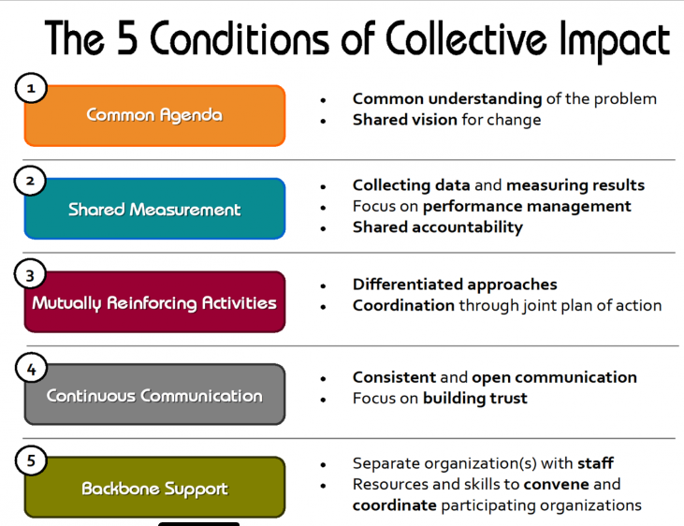

Slide 47
Steering Committee
Monique Baptiste-Good
Project Director, Newark Strong Healthy Communities Initiative
Michael Bright
President/CEO, YMCA of Newark and Vicinity
Tia Collier
Project Director, Newark Fairmount Promise Neighborhood
Vivian Cox Fraser
President/CEO, Urban League of Essex County
Rhonda Lewis
Executive Director, Greater Newark LISC
Keri Logosso-Misurell
Executive Director, Greater Newark Healthcare Coalition
John Mooney
CEO and Founding Editor, NJSpotlight
Margarita Muniz
Executive Director, Family and Community Engagement, Newark Public Schools
Denise V. Rodgers
Vice Chancellor for Interprofessional Programs, Rutgers Biomedical and Health Sciences
Kate Shoemaker
COO, South Ward Children's Alliance
Jen Velez
Senior VP of Strategy and Planning, RWJ Barnabas Health
Charlie Venti
Executive Director, The Nicholson Foundation
Catherine Wilson
President/CEO, United Way of Essex and West Hudson
Cecilia Zalkind
President/CEO, Advocates for Children of New Jersey
Beth Milton
Believe in a Healthy Newark Project Coordinator

Slide 48
WHO Definition of Health - 1948
Health is a state of complete physical, mental and social well-being and not merely the absence of disease or infirmity.

Slide 49
Housing
Local Initiatives Support Corporation (LISC) - Greater Newark
  Rhonda Lewis, Executive Director
Unified Vailsburg Services Organization
  Patricia Anthony, Director of Housing Development

Slide 50

Partnering to Build Vibrant, Safe and Healthy Neighborhoods
December 20, 2016

Slide 51
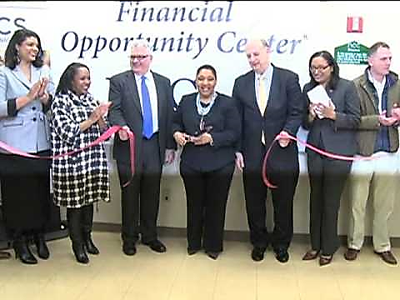
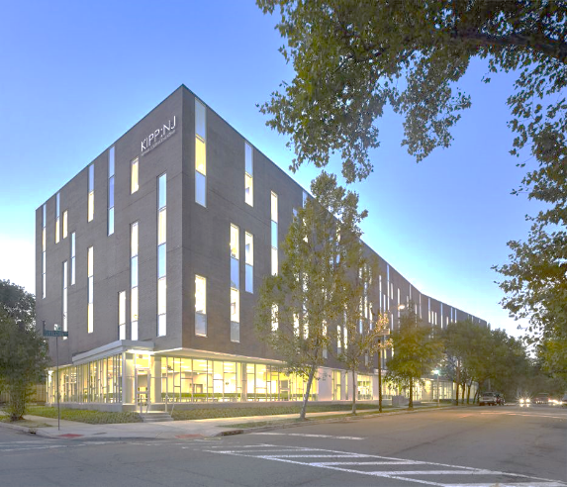
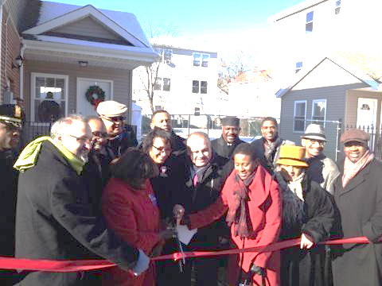
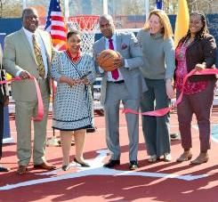

Our investments in Newark’s West Ward
Affordable Housing & Real Estate
Increase Family Income and Wealth
Improve Access to Quality Education
Foster Safe and Healthy Communities

Slide 52
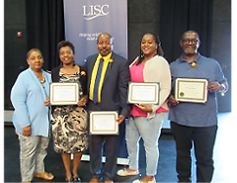
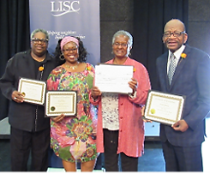
Our Investments in Resident Leadership
Neighborhood Resident Leadership Academy
Thriving Neighborhoods Project in Fairmount Heights

Slide 53

Unified Vailsburg
Services Organization
“Creating a Stable and Compassionate Community”

Slide 54
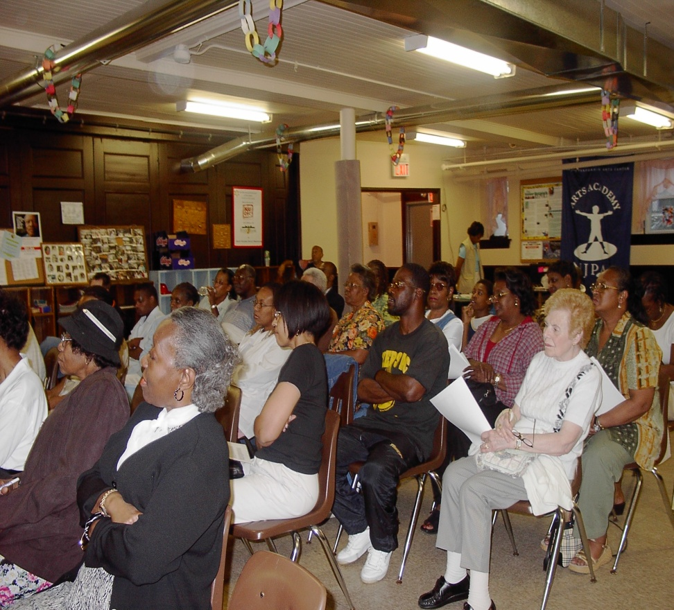
Neighborhood Plan Community Meeting
Unified Vailsburg Services Organization (UVSO) completed a neighborhood plan in 2006 that was created with input and involvement from over 600 people who live in the Vailsburg community in Newark. The plan was approved by the State of New Jersey – Department of Community Affairs in 2008.
Using the plan as a tool to create the new programs and facilities called for by the community, UVSO has leveraged $2 million of Neighborhood Revitalization Tax Credits ( NRTC) to produce over $11 million in housing and economic development in Vailsburg.

Slide 55
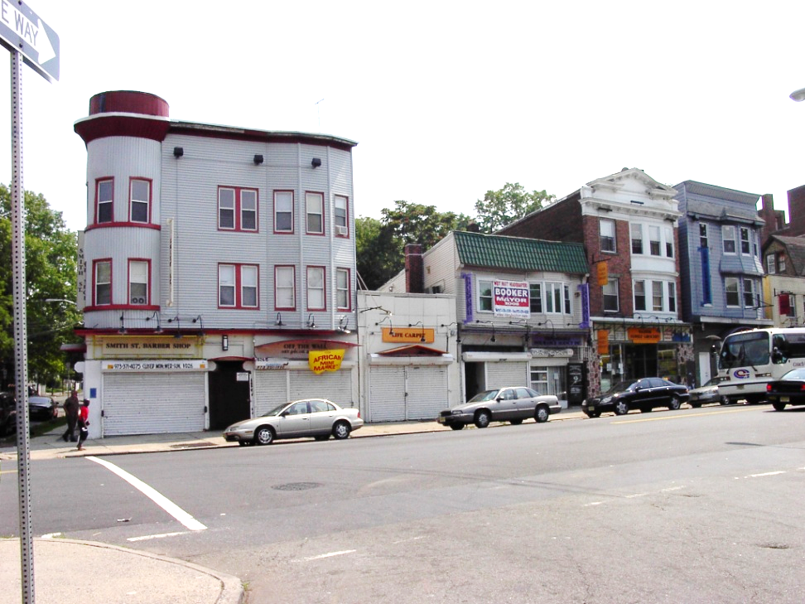
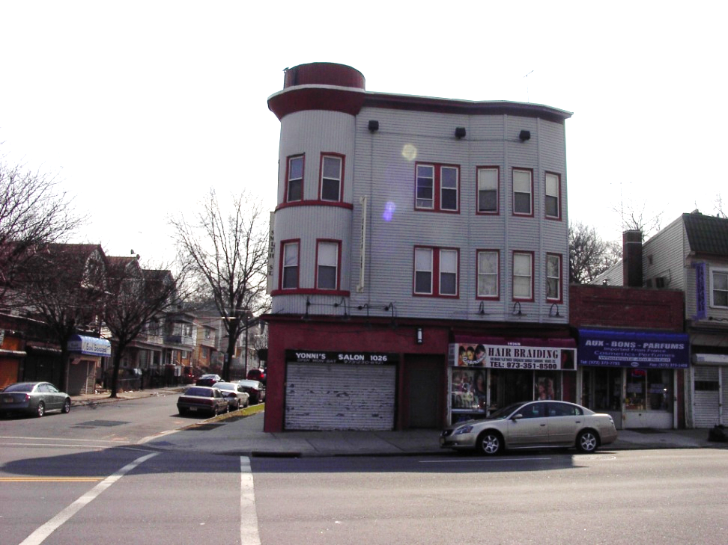
1026-1028 SOUTH ORANGE AVE. RESIDENTIAL RENTALS & THREE STORE FRONTS
BEFORE REPAIRS
AFTER REPAIRS

Slide 56
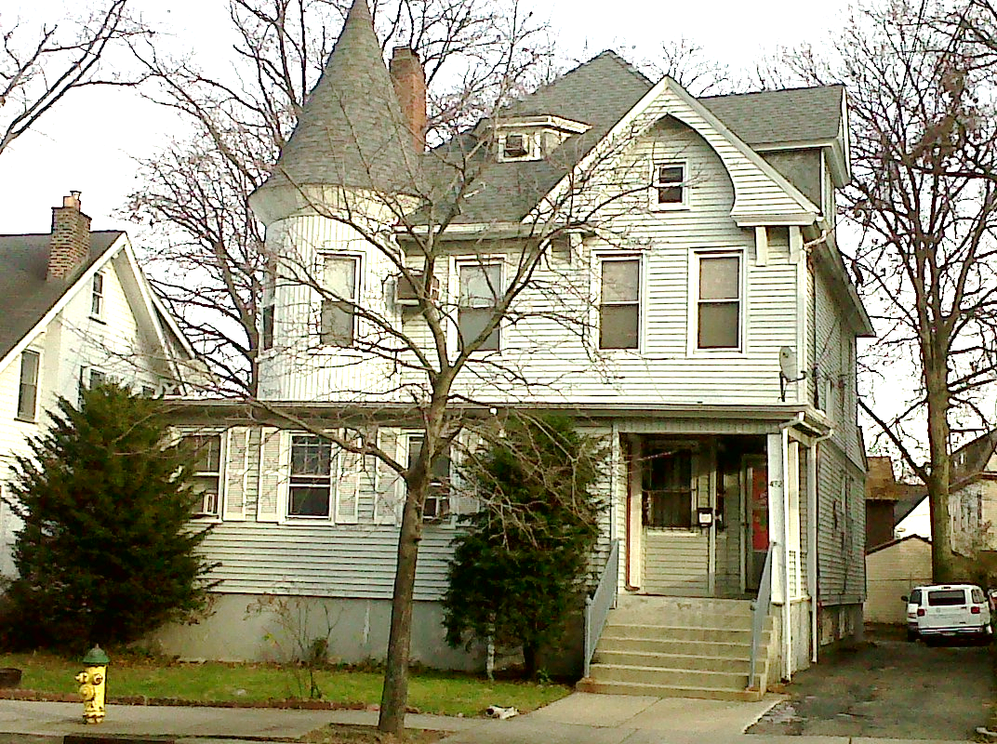
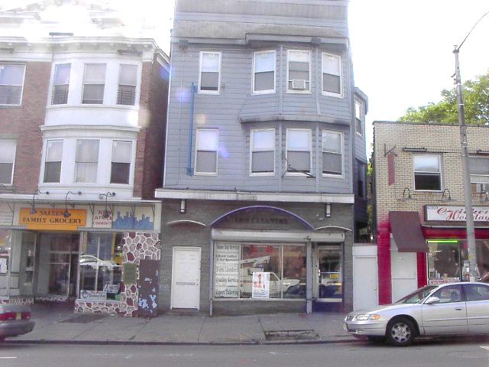
UVSO Rental Properties

Slide 57
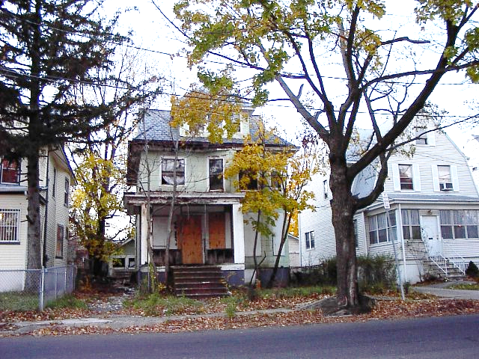
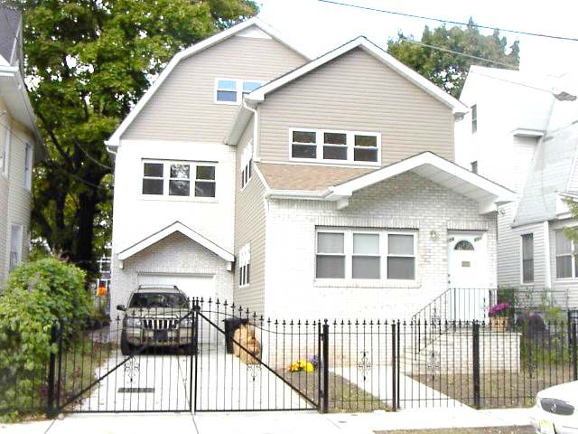
BEFORE AND AFTER PICTURES OF 109-111 MAYBAUM AVE.

Slide 58
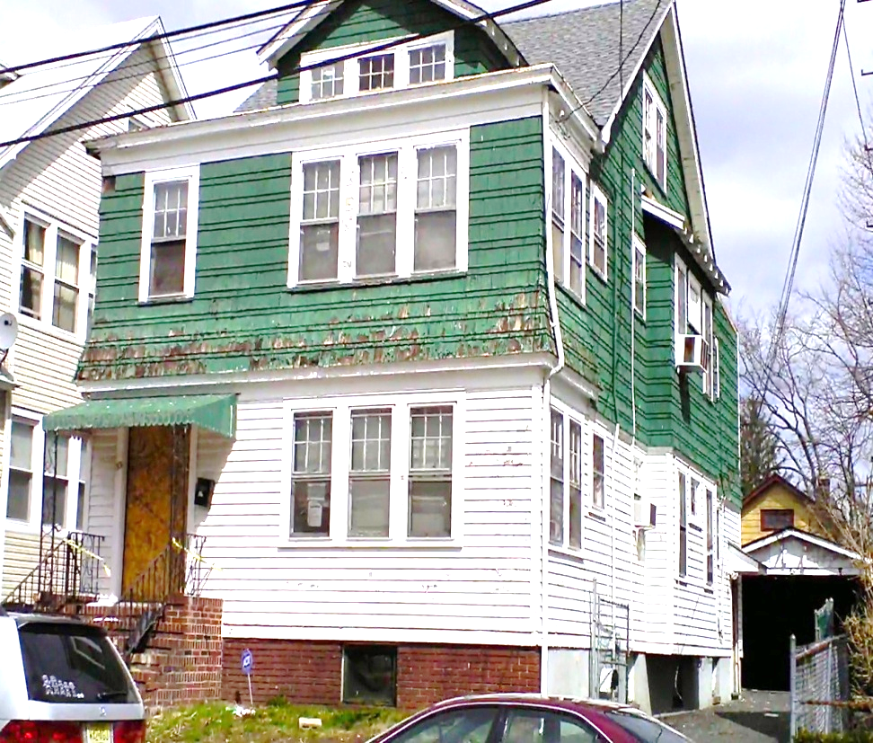
Vailsburg Heights NRTC Project
UVSO’s second NRTC project, launched in 2011, is Vailsburg Heights. This is a $1.9 million venture to acquire, restore, and sell or rent 7 foreclosed homes at locations throughout the Vailsburg neighborhood. At this writing, 5 of the houses have been completed, 3 are sold, 2 are rented, and the final 2 homes are in the finish stage of construction.
Vailsburg Heights was made possible by a $250,000 investment from J.P. Morgan Chase, and funding from the City of Newark through the Neighborhood Stabilization Program (NSP). Housing and Neighborhood Development Services (HANDS) was another important partner that identified and bulk-purchased foreclosed properties throughout Essex County, 5 of which were acquired by UVSO.

Slide 59
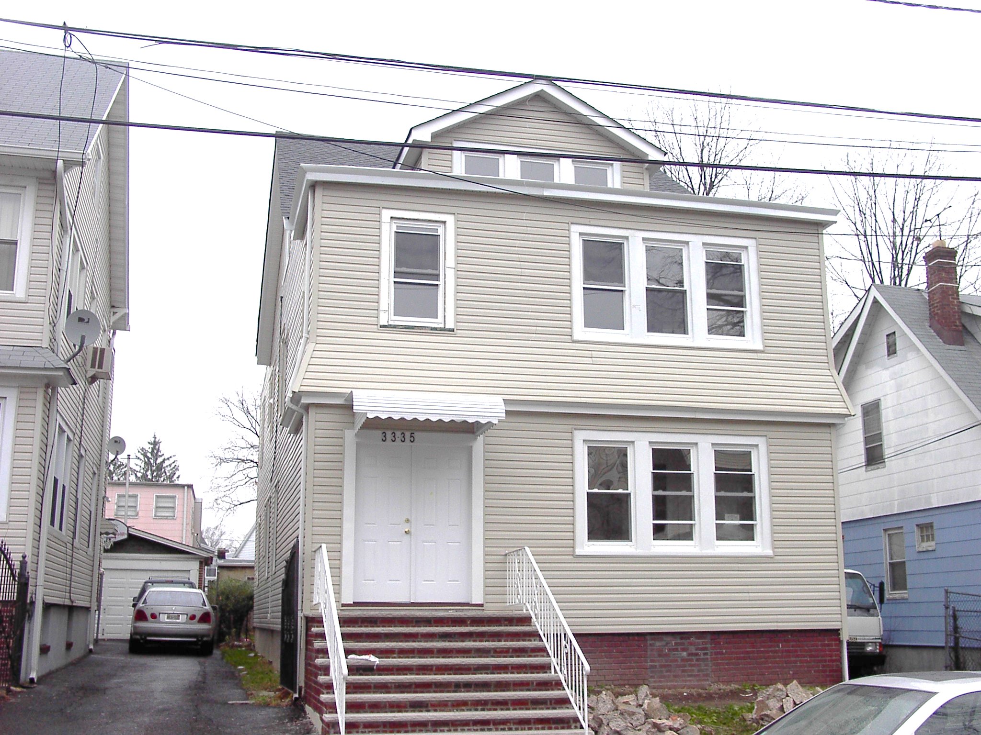

Slide 60
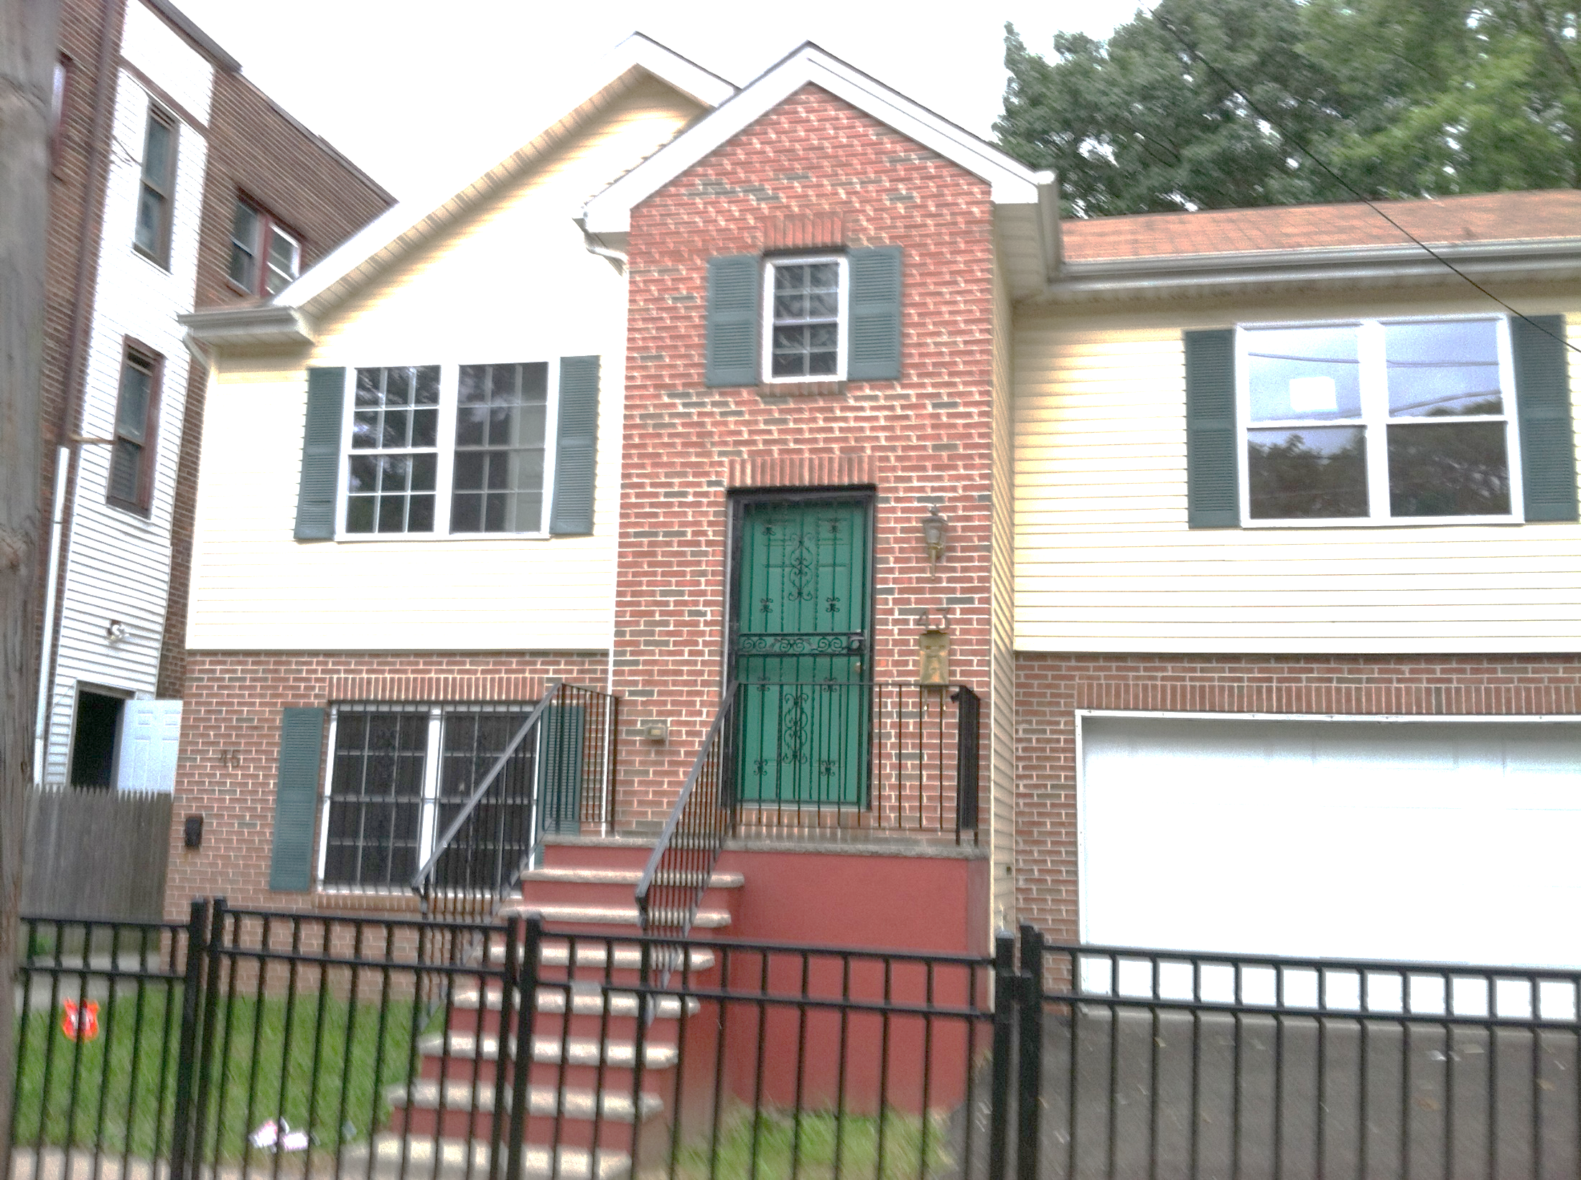

Slide 61
Questions
What are the synergies in current approaches, initiatives, strategies, opportunities?
Where are the gaps?
How can we collaborate to expand, improve, strengthen?
How can stakeholders (University, churches, hospitals, etc.) work together to support improved outcomes?

Slide 62
Next Steps
Bi-Monthly Meetings
Suggested Topics
Shared Notes
Recommendation for other stakeholders

Slide 63
For more information & suggestions
Please contact:
973-353-1630
Habeebah Yasin, Graduate Intern
Donita Devance, Associate Director Office University Community Partnerships

Slide 64
“I believe we can change the world if we start listening to one another again. Simple, honest, human conversation. Not mediation, negotiation, problem solving, debate or public meetings. Simple, truthful conversations where we have a chance to speak, we each feel heard, and we each listen well.” – Margaret Wheatley
Notes:
A quote from Margaret Wheatley stood out….( an inspirational writer who studies organizational behavior whose approach includes systems thinking and leadership: she believes that we can create good human society wherever we are, whenever we can, with people and resources that are available to us now….

