Slide 2
West Ward Community Coalition Community Conversations
Building a Stronger Community:
Transforming the West Ward
May 2019

Slide 3
Community Health and Wellness
Federally Qualified Health Center (FQHC)
Saint James Medical Center 432-446 South Orange Avenue
Addresses medical needs and physical health
Prevention, Screening, and Monitoring
Family Planning, OBGYN, Pediatrics, and WIC
Adult Medicine and Geriatrics
Social Work and Integrated Pediatric Behavioral Health
saintjameshealth.com

Slide 4
Community Health and Wellness
Anchor health and wellness-based institutions
LA Fitness 237-249 South Orange Avenue (corner of Bergen Street)
Adds fresh look to a major intersection
Promotes physical health
Demonstrates sustained financial growth in the community
lafitness.com

Slide 5
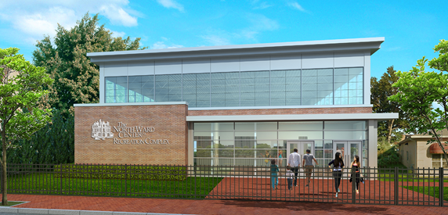
Education and Recreation
North Ward Center’s new Recreation Center
Help to rejuvenate Roseville section
Promote a healthier, active lifestyle
Provide an alternative to youth on the streets
northwardcenter.org
The Center for Autism
Modern, well thought out facility
Provides support for families dealing with Autism Spectrum Disorders (ASDs) and Pervasive Developmental Delays (PDD)
Continued education and recreation
centerforautismnj.org

Slide 6
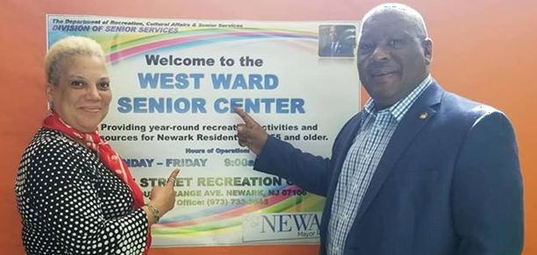
Education and Recreation Boylan Street Recreation Center
West Ward Senior Center
Provide recreation for senior citizens
Maximize use of already existing facility
Encourage seniors to engage in a more active lifestyle
D.O.R.C.A. Boxing Program
Promotes healthy lifestyle
Reinforces the importance of academics
Teaches social interaction and conduct

Slide 7
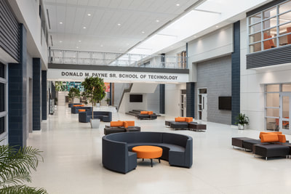
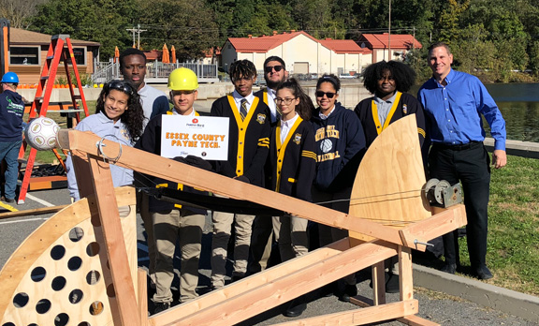
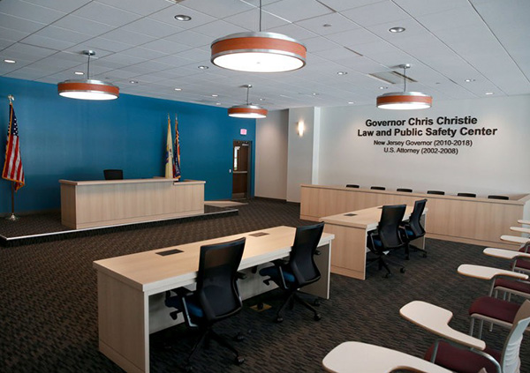
Education and Recreation
Essex County Donald M. Payne Sr. School of Technology
State of the art educational facility and programs
Culinary Arts
Law, Public Safety, Corrections & Security
Web Design / Game Design
Cosmetology
Construction Trades & Technology
Accounting Technology
Performing Arts
Music Technology
Digital Filmmaking & Television Production
Entertainment & Production Arts
Graphic & Fashion Design
Masonry
Plumbing
Electrical
Carpentry
Marketing
Engineering

Slide 8
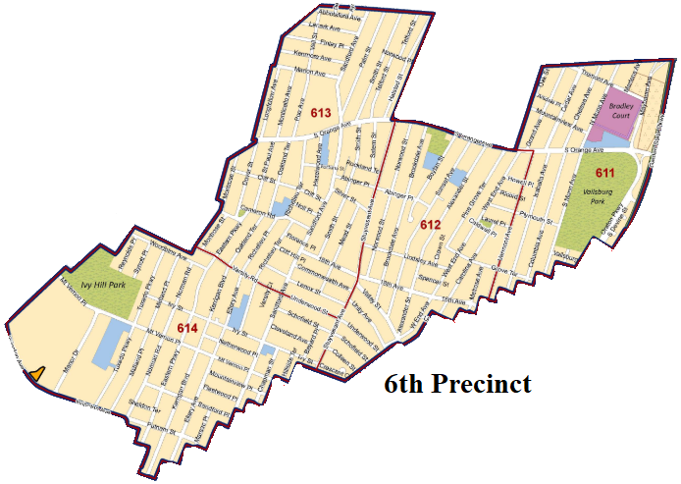
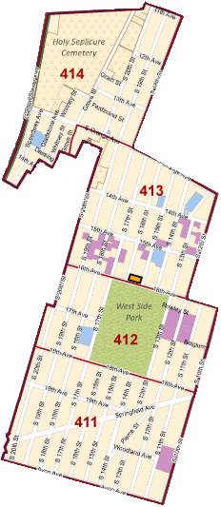
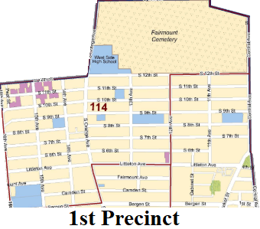
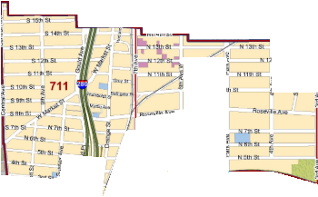
Public Safety
3 New Police Precincts
Smaller coverage areas
Faster response times
A better understanding of
community dynamics
Precincts and Coverage Area
1st Precinct – Fairmount
4th Precinct – West Side Park
6th Precinct – Vailsburg / Ivy Hill
7th Precinct – Roseville
*Essex County Sheriff's Patrol HQ
(West Market Street and Myrtle Avenue)

Slide 9
10% decline in total crime

Slide 10
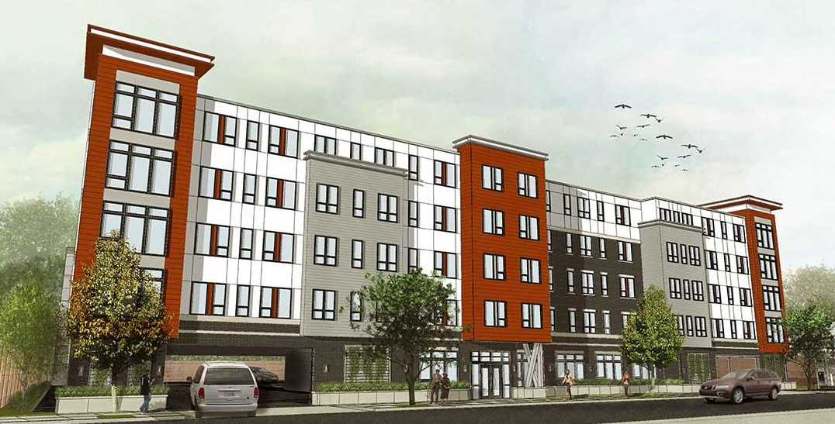
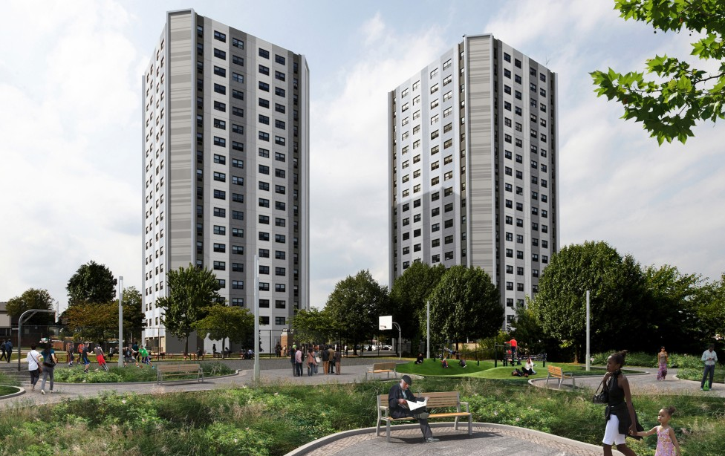
Economics, Housing, and Development
Goals
Inclusionary housing
Increased density
Employment
Rejuvenation
Home ownership
Green space
Cleaner communities
Brighter neighborhoods
Modern design
377-387 N. 5th Street
159-161 Isabella Avenue
Georgia King Village

Slide 11
Economics, Housing, and Development
Phase I Schedule 1: South Orange Avenue from Dover Street to Bergen Street Schedule 2: Sanford Avenue from the Irvington border to the East Orange border Schedule 3: 18th Avenue from Sanford Avenue to Myrtle Street Schedule 4: Mt. Vernon Place from Eder Terrace to Sanford Avenue
www.partnershipwestinc.org

Slide 12
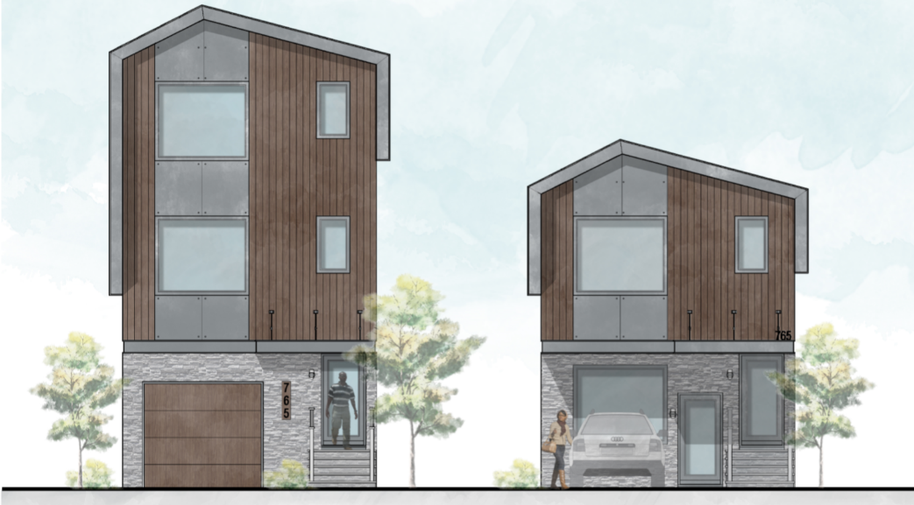
Economics, Housing, and Development
Urban League of Essex County (ULEC)
Constructing new 2- and 3-family homes
Generate income for the property owner
Encourage more density
Provide an alternative option for affordable income residents
HOUSING COUNSELING
Financial Education and Empowerment Workshops
Rental Counseling and Assistance
Credit and Financial Coaching
Homeownership Education and Counseling
Homeowner Services
Foreclosure Prevention and Rescue Counseling

Slide 13
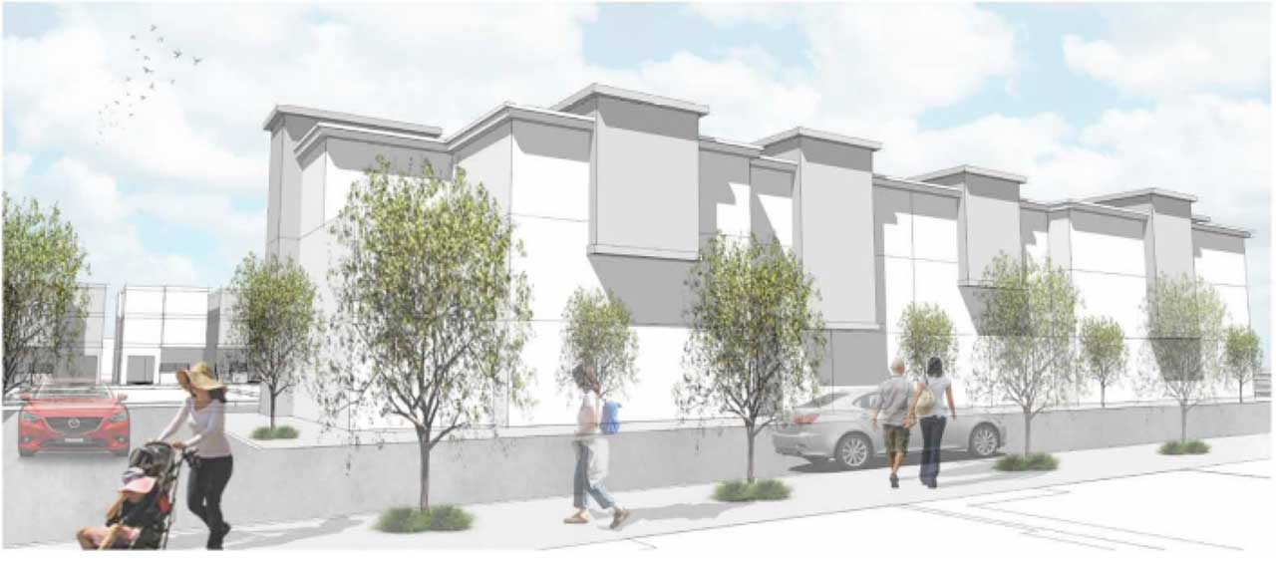
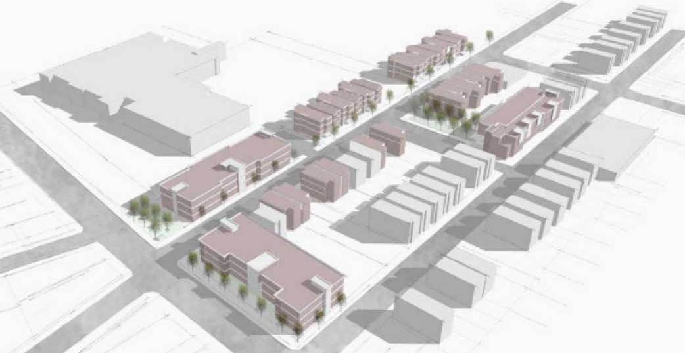
Economics, Housing, and Development
West Side Heights
Revitalize a blighted neighborhood
Increase population density along the main corridor
Provide a boost to neighborhood businesses
Provide homeownership opportunities

Slide 14
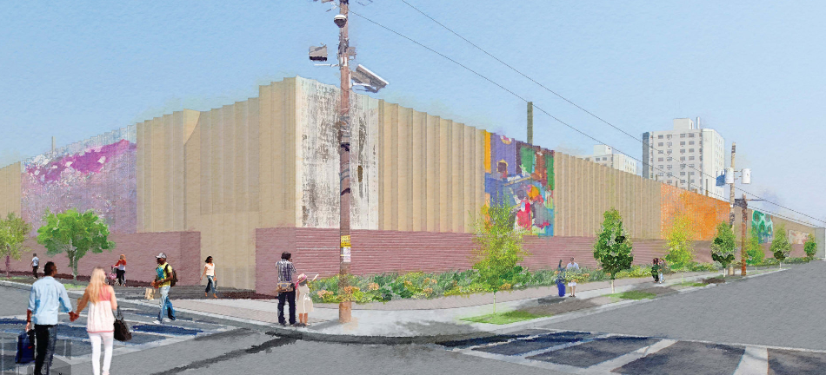
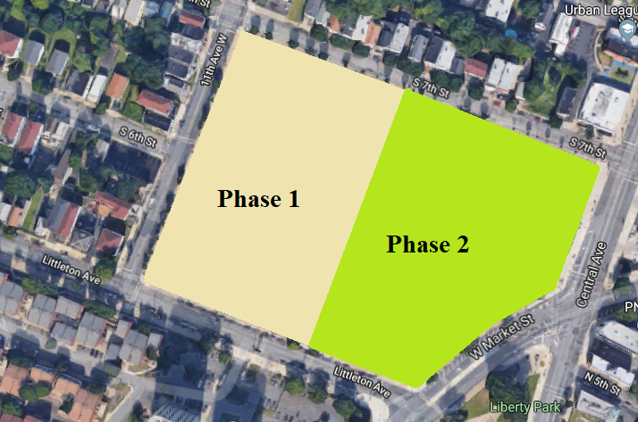
Economics, Housing, and Development
Fairmount Heights PSE&G Switching Station and Art Wall
Phase 1
Replace existing blighted structure
Neighborhood beautification mural
Large scale infrastructure improvements
Phase 2
Mixed use commercial and residential
Addition of anchor institution
Green space

